Slide 1
An Garda Síochána
Advice for a Safe Halloween
Garda Schools Programme 2021

Slide 2
The Law
It is against the law to:
Possess or have a firework
Sell or supply (give someone), without a licence.
Light fireworks.
Throw an ignited (lit) firework at any person or property.
Penalty = fine of up to €10,000 or 5 years imprisonment or both.
An Garda Síochána

Slide 3
Use of Fireworks can Cause:
Injury and distress.
Great distress to animals.
Annoy older people.
House alarms set off.
Damage to property with fire, if fireworks continue to burn after landing.
An Garda Síochána

Slide 4
How do injuries occur?
Fireworks type:- All fireworks can cause injury (even sparklers burn at more than 700°C).
Being too close:- Injuries may result from being too close to fireworks when they explode.
Curiosity:- People are often excited and curious around fireworks. For example, when they examine a ‘banger’ dud that initially failed to ignite.
An Garda Síochána

Slide 5
What kind of injuries can occur?
The body parts most often injured are the hands and the head.
More than half of injuries are burns.
Fireworks can be associated with blindness, third degree burns, permanent scarring, and loss of fingers.
Fireworks can also cause life-threatening residential, and motor vehicle fires.
An Garda Síochána

Slide 6
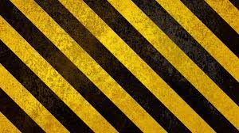
WARNING
The following slides contain graphic images of injuries sustained from fireworks
An Garda Síochána

Slide 7
An Garda Síochána

Slide 8
Did you know?
Fire Brigade and Ambulance Services responded to over 1000 callouts nationwide during Halloween 2019.
People often build bonfires too close to houses, parked cars, electrical wires. This can lead to house fires
Dozens of children are left with serious burns and hand injuries each year
Injuries also occur from explosions within bonfires from gas cylinders and other objects.
More than €1 million was spent by local authorities cleaning up Halloween bonfires and fireworks last year.
An Garda Síochána

Slide 9
Tips for a Safe Halloween
Stay a safe distance from bonfires and fireworks
Have an adult with you when “trick or treating” or at events.
If you dress up in dark clothes, add reflective material so that you can be seen by motorists and cyclists.
Make sure costumes are fire resistant
Do not buy, use, ignite or supply fireworks.
Keep pets indoors on Halloween night.
Check on your elderly neighbours who may be frightened
An Garda Síochána

Slide 10
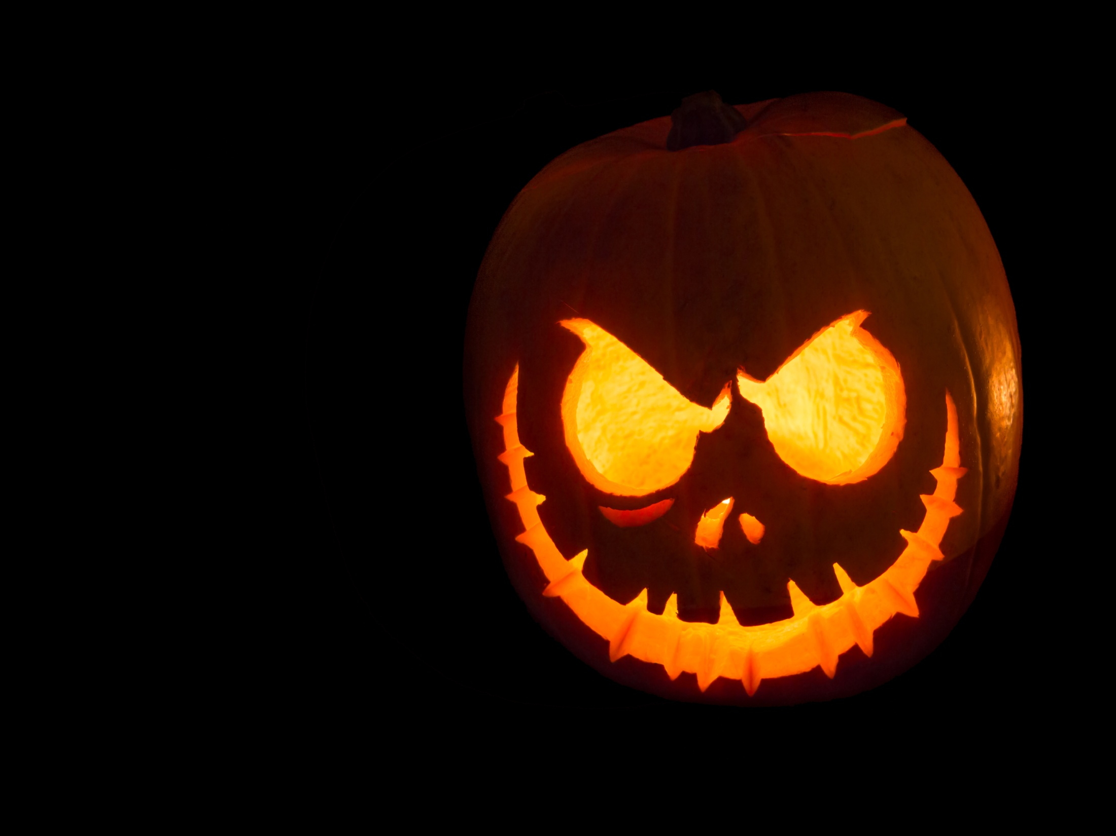
Happy Halloween
Act safely and responsibly this Halloween

